Slide 1

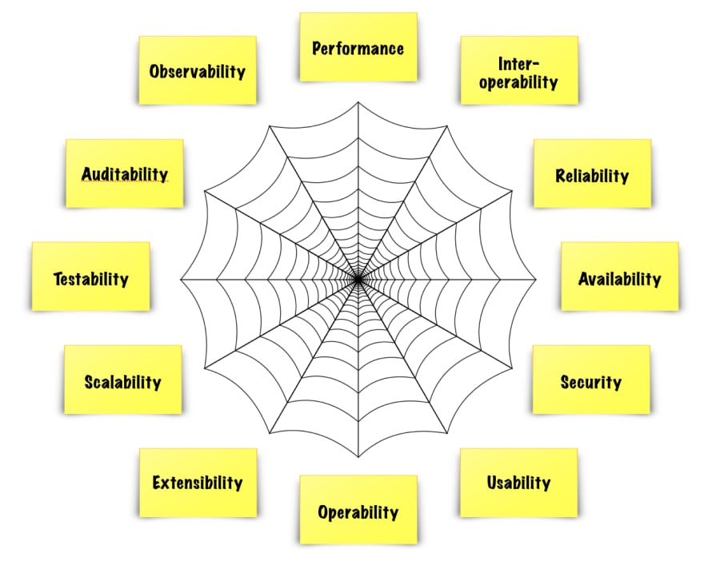
Quality Attributes Quiz
https://bit.ly/4ayUuMU

